Slide 1

Exploratory Data Analysis & Visualization on Udemy Course Datasets Using Power BI

Slide 2

Hello!
My name is Jammal Adeyemi
Just here to present my analysis and insights to my respective colleagues in the building.

Slide 3
Our process is easy
Recommendation & Conclusion
Lastly, we made recommendation based on our insights.
03
Transforming the Datasets
Here, we got the datasets and transformed it so that we can make proper analysis & insights.
01
02
Analysis Questions
Answering of importants question for our analysis.

Slide 4
1. Udemy Courses

Slide 5
Information is the oil of the 21st century, and analytics is the combustion engine

Slide 6
About this Datasets
This dataset contains 3.682 records of courses from 4 subjects (Business Finance, Graphic Design, Musical Instruments & Web Design) taken from Udemy.
Udemy is a massive online open course (MOOC) platform that offers both free & paid courses.
This data has the following column names; course_id, course_title, url, is_paid, price, num_subscribers, num_reviews, num_lectures, level, content_duration, published_timestamp, and subject.

Slide 7
2. Transforming the Data

Slide 8
The dataset was provided by Blossom Academy
Since the data is in CSV format we start by clicking on “Get Data” > “Text/CSV” > “Locate File Location and import”.
Once done importing, I dived into the Power Query Editor to start making the necessary transformation.
Corrected some columns with the wrong datatypes setting.
Dropped duplicate & content_duration that was less than 1mins

Slide 9
Extracted the “month”, “year”, and “year quarter” columns from the “published_timestamp” column.
Created a new column, where I changed the “is_paid” column True/False to paid/unpaid.
Calculated a new measure called “profit” to get the total profit Udemy made per course.
Hide some columns that won’t be needed for visualization like url, is_paid, content_duration etc.

Slide 10
3. Analysis Questions

Slide 11
Subjects/Category –
What is the distribution of subjects
How many courses per subject
Distribution of subjects per year
How many people purchase a particular subject
Which subject is the most popular
Published year –
Number of courses per year
Which year has the highest number of courses
Which month generate the highest number of course and profits
What is the trend of course per year

Slide 12
Levels –
How many levels do we have
What is the distribution of courses per level
Which subject have the highest levels
How many subscribers per level
How many courses per level
Distribution of Courses –
Which courses have the highest duration (paid or not)
Which courses have a higher duration
Duration vs number of subscribers

Slide 13
Subscribers –
Which course has the highest number of subscribers
Average number of subscribers
Number of subscribers per subject
Number of subscribers per year
Distribution of Courses –
Which courses have the highest duration (paid or not)
Which courses have a higher duration
Duration vs number of subscribers
Correlation Questions –
Does the number of subscribers depend on Price, and No of Review
Does price influence Subscription and Review

Slide 14
4. Data Visualization

Slide 15
I. Subscribers Analysis

Slide 16
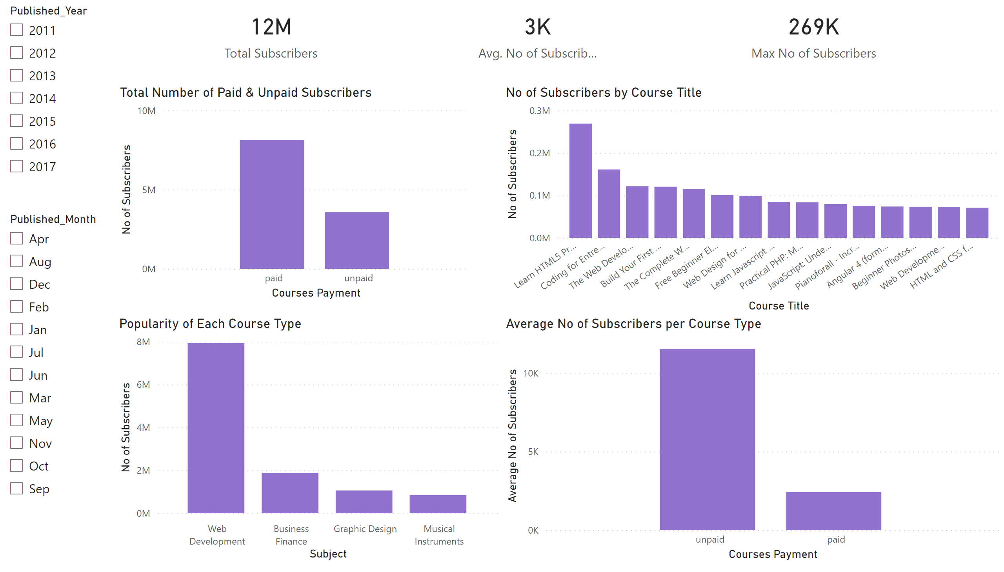
Subscribers
Notes:
slicer
No alt text provided
slicer
No alt text provided
card
No alt text provided
card
No alt text provided
columnChart
No alt text provided
Total Number of Paid & Unpaid Subscribers
No alt text provided
card
No alt text provided
Average No of Subscribers per Course Type
No alt text provided
Popularity of Each Course Type
No alt text provided

Slide 17
The most popular subject amongst the subscribers is Web Development, followed by Business Analysis
Udemy has 12M total subscribers between the duration of 2011-2017
Average number of subscribers: “3193”
The maximum number of subscribers for a course is “269k”, which is “Learn HTML5 Programming from scratch” which falls under “Web development” Subject category.
Filtering further, I found that the year it occurs was 2013 which has a high number of unpaid subscribers.

Slide 18
II. Level Analysis

Slide 19
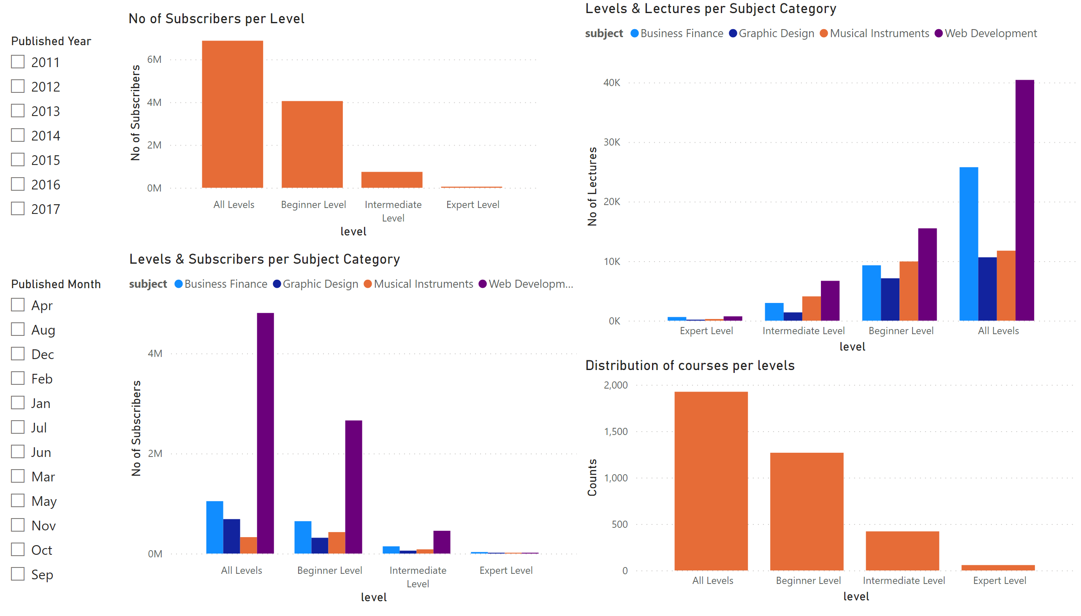
Levels
Notes:
slicer
No alt text provided
slicer
No alt text provided
Levels & Lectures per Subject Category
No alt text provided
No of Subscribers per Level
No alt text provided
Levels & Subscribers per Subject Category
No alt text provided
Distribution of courses per levels
No alt text provided

Slide 20
We have 4 levels as we can see from the visualization.
“All Levels” has the highest distribution based on subscribers and courses.
“Web development” subject generated the highest per lectures & subscribers across all levels.
“2015” had the highest number of subscribers per level & courses.

Slide 21
III. Price & Lecture Analysis

Slide 22
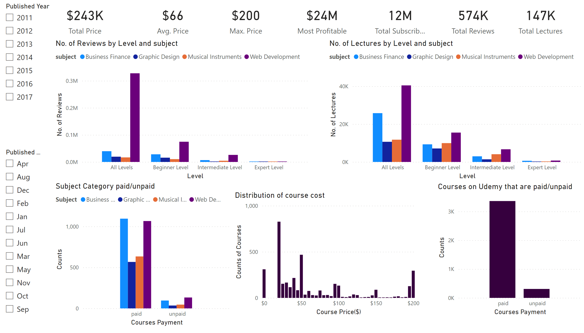
Reports
Notes:
slicer
No alt text provided
slicer
No alt text provided
card
No alt text provided
card
No alt text provided
card
No alt text provided
card
No alt text provided
card
No alt text provided
card
No alt text provided
card
No alt text provided
Courses on Udemy that are paid/unpaid
No alt text provided
Distribution of course cost
No alt text provided
Subject Category paid/unpaid
No alt text provided
clusteredColumnChart
No alt text provided
clusteredColumnChart
No alt text provided

Slide 23
The max price is “$200”, filtering further to get the course title and subject which are “Ultimate Investment Banking course” and “Business Finance” respectively.
The most profitable course made over $24M, which is the “Web Developer Bootcamp”
$20 has the highest distribution of course cost, followed by $50 then $0.
“Web Development” has the highest number of unpaid subject.
“Business Finance” has the highest number of paid subject.

Slide 24
“Web Development” has the highest number of subject per review across all level, followed by “Business Finance”.
“Web Development” has the highest number of subject per number of lectures across all level, followed by “Business Finance”.

Slide 25
IV. Year Analysis

Slide 26
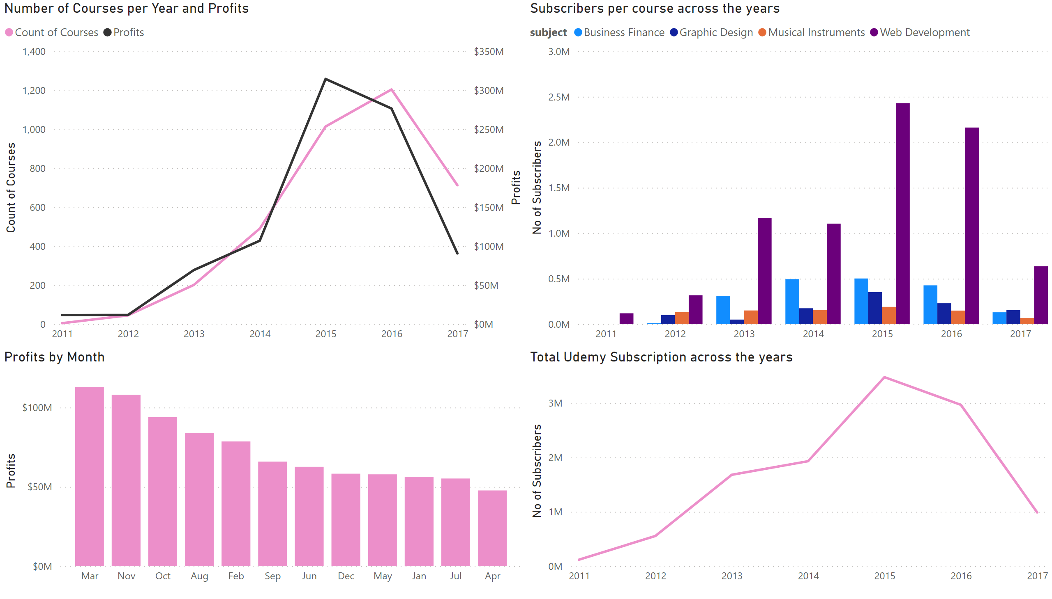
Year
Notes:
Total Udemy Subscription across the years
No alt text provided
Subscribers per course across the years
No alt text provided
Number of Courses per Year and Profits
No alt text provided
columnChart
No alt text provided

Slide 27
2015 has highest number of subscribers across the years
2015 generated the highest profit across the years
2016 has the highest number of courses published on Udemy
Web Development in 2015 topped the chart when it comes total subscribers across the years
March generated the highest profit in the month section

Slide 28
V. Correlation Analysis

Slide 29
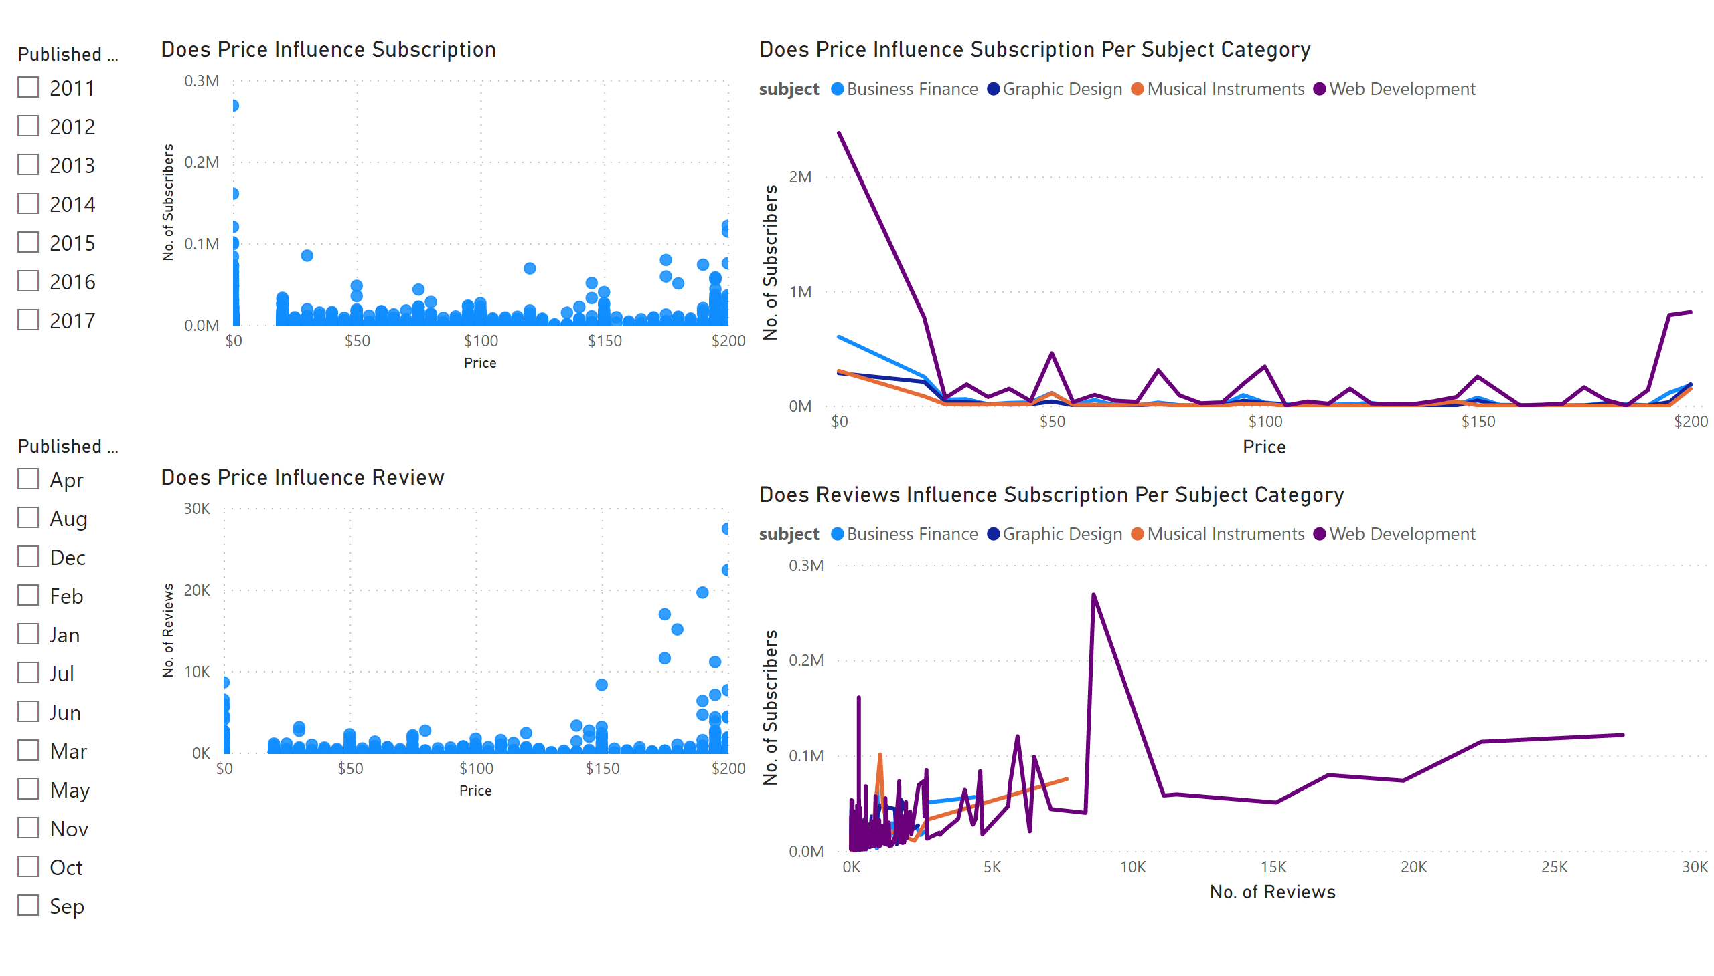
Correlation
Notes:
Does Price Influence Subscription Per Subject Category
No alt text provided
Does Reviews Influence Subscription Per Subject Category
No alt text provided
slicer
No alt text provided
slicer
No alt text provided
Does Price Influence Subscription
No alt text provided
Does Price Influence Review
No alt text provided

Slide 30
The Price actually influence users subscription as there was high intake on free courses on the platform.
The price influences the reviews as users that subscribe for a course has a high reviews compare to the free courses.
The price influences what kind of subscription the user made, as there were more subscribers taking “Web Development” free subject.
Lastly, users review had a some influence to user subscription but not as much has prices.

Slide 31

RECOMMENDATION & CONCLUSION

Slide 32
From my analysis,
Udemy has had its fair share of glory. From the data available, the peak was in 2015 after which it had a decline.
This could be due to a surge of other learning platforms.
The most popular course across all time, price and level is web development.
So, if I am to put a course on Udemy it would be under web development.
Price range of 20-50 USD tagged “All Levels” and between 10-12hrs long.

Slide 33

Thanks!
Any questions?
You can send me a mail
oabass7@gmail.com

